Slide 2
Topics
Introduction to Inheritance
Polymorphism

Slide 3
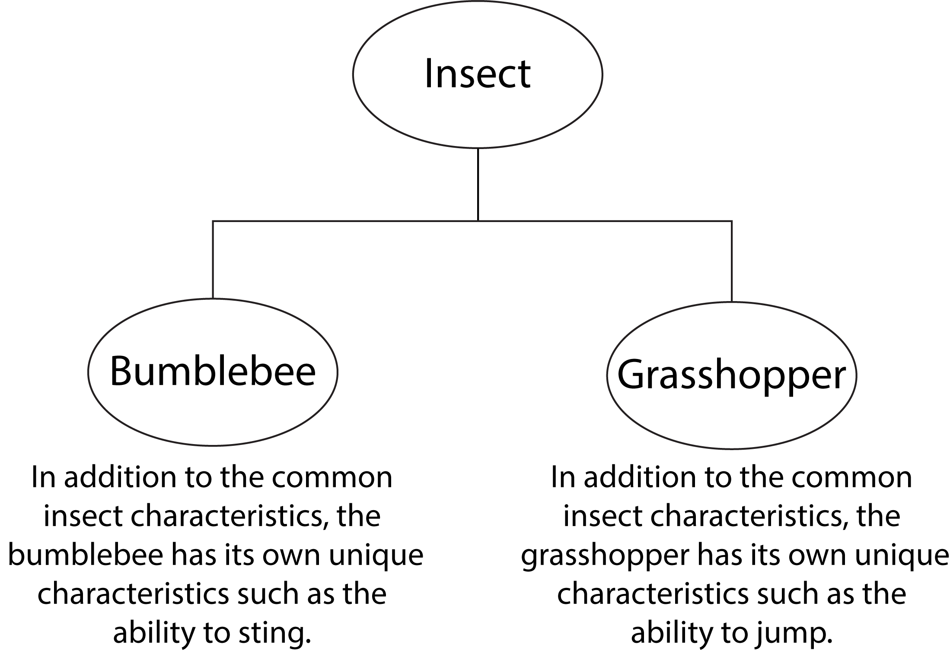
Introduction to Inheritance
In the real world, many objects are a specialized version of more general objects
Example: grasshoppers and bees are specialized types of insect
In addition to the general insect characteristics, they have unique characteristics:
  Grasshoppers can jump
  Bees can sting, make honey, and build hives

Slide 4
Introduction to Inheritance
Inheritance: used to create an “is a” relationship between classes
Superclass (base class): a general class
Subclass (derived class): a specialized class
  An extended version of the superclass
    Inherits attributes and methods of the superclass
    New attributes and methods can be added

Slide 5
Introduction to Inheritance
Let’s say that we need to create classes for cars, pickup trucks, and SUVs
All are automobiles
  Have a make, year model, mileage, and price
  This can be the attributes for the base class
In addition:
  Car has a number of doors (2 or 4)
  Pickup truck has a drive type (2 or 4 wheel)
  SUV has a passenger capacity

Slide 6
The Automobile Class
class Automobile:
def __init__(self, make, model, mileage, price):
self.__make = make
self.__model = model
self.__mileage = mileage
self.__price = price
def set_make(self, make):
self.__make = make
def set_model(self, model):
self.__model = model
def set_mileage(self, mileage):
self.__mileage = mileage
def set_price(self, price):
self.__price = price
def get_make(self):
return self.__make
def get_model(self):
return self.__model
def get_mileage(self):
return self.__mileage
def get_price(self):
return self.__price
Stored in a module named vehicles.

Slide 7
Subclasses
In a class definition for a subclass:
  To indicate inheritance, the superclass name is placed in parentheses after subclass name
    Example: class Car(Automobile):
  The initializer method of a subclass calls the initializer method of the superclass and then initializes the unique data attributes
  The initializer can be invoked in two ways:
    superclass_name.__init__(self) # Old style
    super().__init__() # preferred style, note that self is not passed as an argument here

Slide 8
The Car Class
class Car(Automobile):
def __init__(self, make, model, mileage, price, doors):
Automobile.__init__(self, make, model, mileage, price)
self.__doors = doors
def set_doors(self, doors):
self.__doors = doors
def get_doors(self):
return self.__doors
The Truck Class
class Truck(Automobile):
def __init__(self, make, model, mileage, price, drive_type):
super().__init__(make, model, mileage, price) # self is not passed as arg
self.__drive_type = drive_type
def set_drive_type(self, drive_type):
self.__drive = drive_type
def get_drive_type(self):
return self.__drive_type

Slide 9
The SUV Class
class SUV(Automobile):
def __init__(self, make, model, mileage, price, pass_cap):
super.__init__(make, model, mileage, price)
self.__pass_cap = pass_cap
def set_pass_cap(self, pass_cap):
self.__pass_cap = pass_cap
def get_pass_cap(self):
return self.__pass_cap
In my example, all three subclasses are stored with the superclass in the module named vehicles.

Slide 10
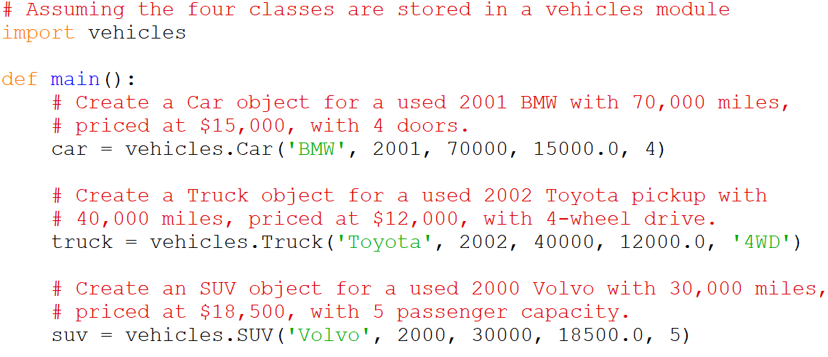
The main method

Slide 11
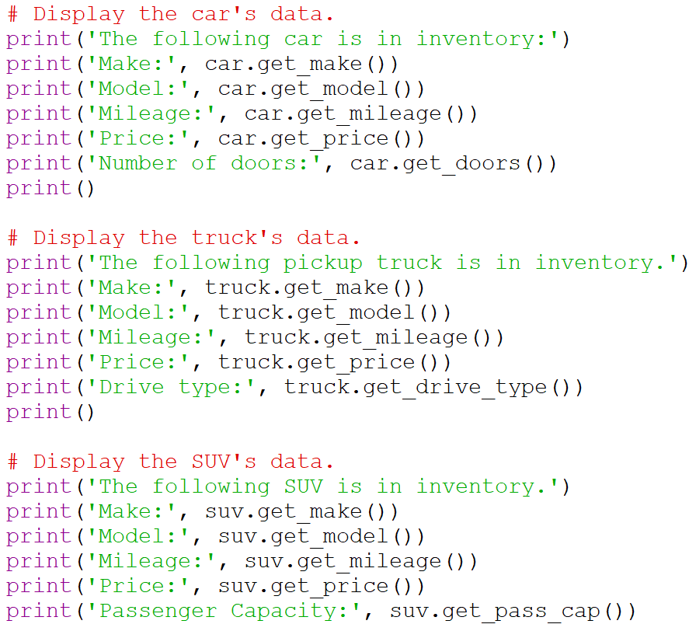
The main method

Slide 12
The main method
# Assuming the four classes are stored in a module named vehicles
import vehicles
def main():
# Create a Car object for a used 2001 BMW with 70,000 miles,
# priced at $15,000, with 4 doors.
car = vehicles.Car('BMW', 2001, 70000, 15000.0, 4)
# Create a Truck object for a used 2002 Toyota pickup with
# 40,000 miles, priced at $12,000, with 4-wheel drive.
truck = vehicles.Truck('Toyota', 2002, 40000, 12000.0, '4WD')
# Create an SUV object for a used 2000 Volvo with 30,000 miles,
# priced at $18,500, with 5 passenger capacity.
suv = vehicles.SUV('Volvo', 2000, 30000, 18500.0, 5)
print('USED CAR INVENTORY')
print('===================')
# Display the car's data.
print('The following car is in inventory:')
print('Make:', car.get_make())
print('Model:', car.get_model())
print('Mileage:', car.get_mileage())
print('Price:', car.get_price())
print('Number of doors:', car.get_doors())
print()
# Display the truck's data.
print('The following pickup truck is in inventory.')
print('Make:', truck.get_make())
print('Model:', truck.get_model())
print('Mileage:', truck.get_mileage())
print('Price:', truck.get_price())
print('Drive type:', truck.get_drive_type())
print()
# Display the SUV's data.
print('The following SUV is in inventory.')
print('Make:', suv.get_make())
print('Model:', suv.get_model())
print('Mileage:', suv.get_mileage())
print('Price:', suv.get_price())
print('Passenger Capacity:', suv.get_pass_cap())
# Call the main function.
if __name__ == '__main__':
main()

Slide 13
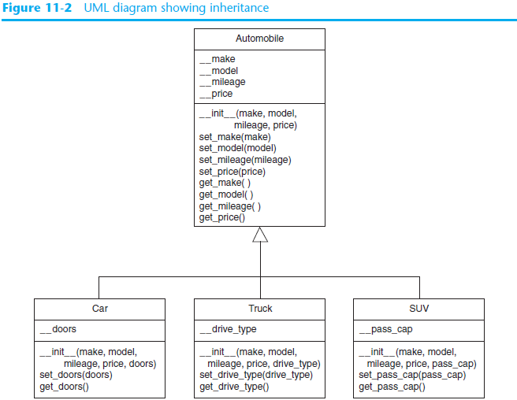
Inheritance in UML Diagrams
In UML diagram, show inheritance by drawing a line with an open arrowhead from subclass to superclass

Slide 14
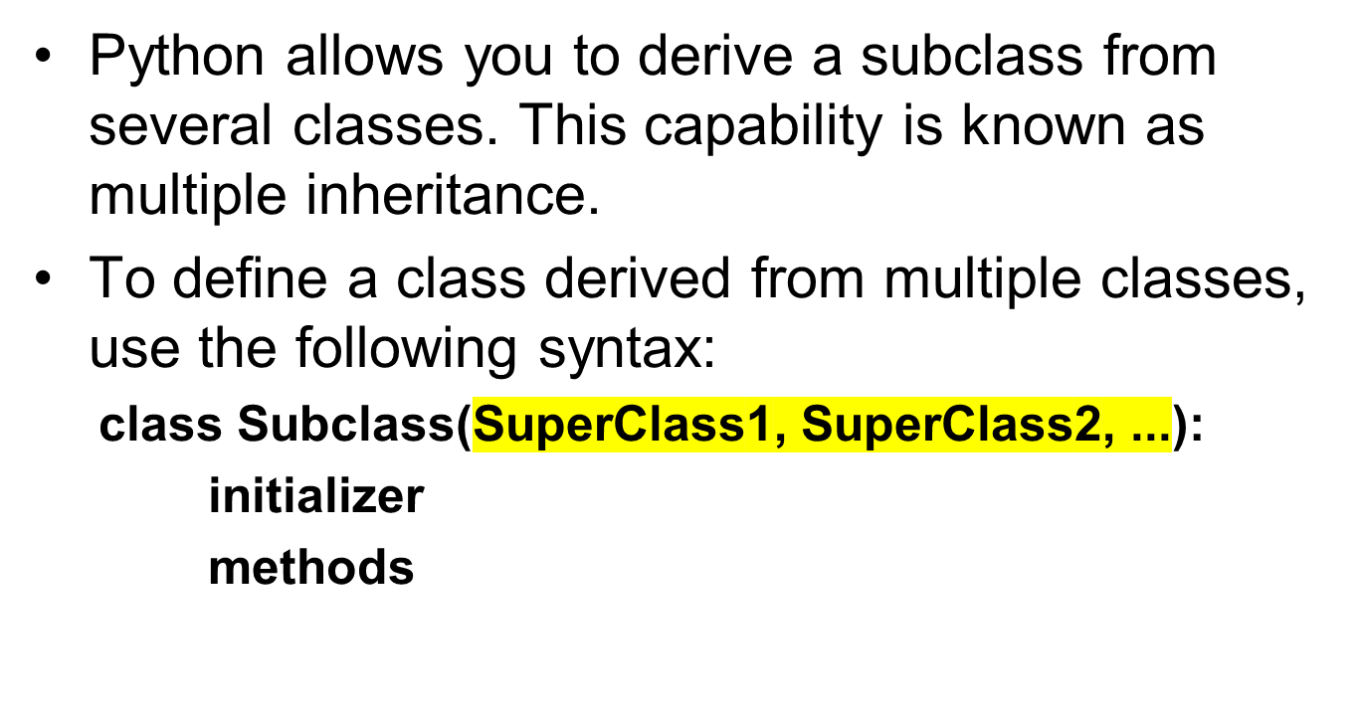
Multiple Inheritance

Slide 15

The object Class
Every class in Python is descended from the object class.
The object class is defined in the Python library.
If no inheritance is specified when a class is defined, its superclass is object by default.
For example, the following two class definitions are the same:

Slide 16
The object Class
It is important to be familiar with the methods provided by the object class so that you can use them in your classes.
All methods defined in the object class are special methods with two leading underscores and two trailing underscores.
A few of these methods are
__new__() ,
__init__() ,
__str__() , and
__eq__(other)

Slide 17
The object Class
The __new__() method is automatically invoked when an object is constructed.
This method then invokes the __init__() method to initialize the object.
Normally, you should only override the __init__() method to initialize the data fields defined in the new class.

Slide 18
The object Class
The __str__() method returns a string description for the object.
By default, it returns a string consisting of a class name of which the object is an instance and the object’s memory address in hexadecimal format.
This message is not very helpful or informative. Usually you should override the __str__() method so that it returns an informative description for the object.

Slide 19
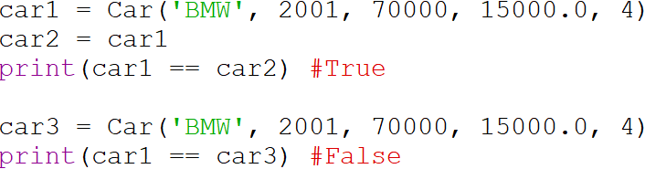
The object Class
The __eq__(other) method returns True if two objects are the same.
If you compare the two objects x and y using x==y, the __eq__ method is called automatically.
You can override this method to return True if two objects have the same contents.
The __eq__ method is overridden in many Python built-in classes such as int , float , bool , string , and list to return True if two objects have the same contents.

Slide 20
Exercise __eq__ Method Solution
Implement the __eq__ method in the Car class such that two cars are the same if they have the same make, model, mileage, price and doors.
def __eq__(self, obj):
if self.get_make() == obj.get_make() and \
self.get_model() == obj.get_model() and \
self.get_mileage() == obj.get_mileage() and \
self.get_price() == obj.get_price() and \
self.__doors == obj.__doors:
return True
else: return False

Slide 21
Polymorphism
The term polymorphism refers to an object’s ability to take different forms.
In Python, polymorphism can be implemented in the form of method overriding.
Method overriding lets you implement the same method in several classes along the inheritance chain.
Python decides which method is invoked at runtime. This is known as dynamic binding.

Slide 22
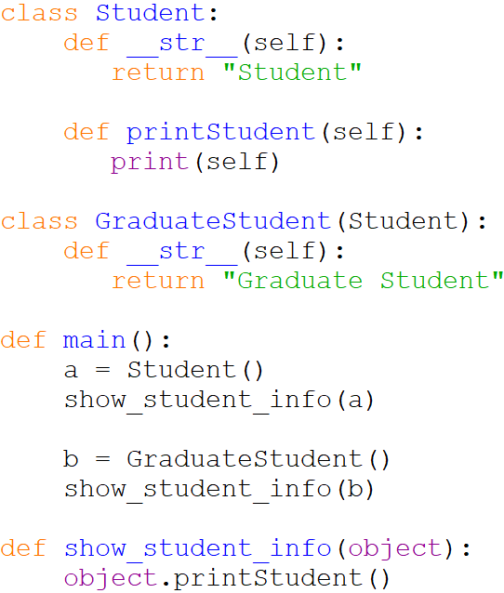
Polymorphism
Since a is an instance of Student , the __str__() method in the Student class is called.
Since b is an instance of GraduateStudent , the __str__() method in the GraduateStudent class is called.

Slide 23
Polymorphism – Complete Code
class Student:
def __str__(self):
return "Student"
def printStudent(self):
print(self)
class GraduateStudent(Student):
def __str__(self):
return "Graduate Student"
def main():
a = Student()
show_student_info(a)
b = GraduateStudent()
show_student_info(b)
def show_student_info(object):
object.printStudent()
# Call the main function.
if __name__ == '__main__':
main()

Slide 24
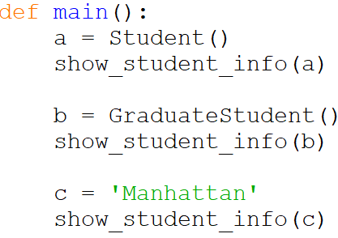
The isinstance Function
If I call the show_student_info () method using an object whose class does not have this method, it will raise an exception.
Here, I call the show_student_info () method using the String object c and it raises an exception.

Slide 25
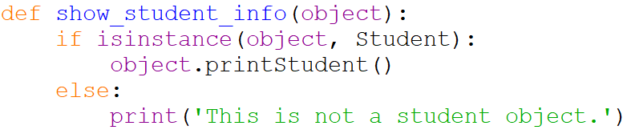
The isinstance Function
To prevent such exceptions from being raised, you can use the isinstance function to determine whether an object is an instance of a class and only call the function if it is an instance of the class.
  Format: isinstance(object, class)

Slide 26
The isinstance Function – Complete Code
class Student:
def __str__(self):
return "Student"
def printStudent(self):
print(self)
class GraduateStudent(Student):
def __str__(self):
return "Graduate Student"
def main():
a = Student()
show_student_info(a)
b = GraduateStudent()
show_student_info(b)
c = 'Manhattan'
show_student_info(c)
def show_student_info(object):
if isinstance(object, Student):
object.printStudent()
else:
print('This is not a student object.')
# Call the main function.
if __name__ == '__main__':
main()

Slide 27
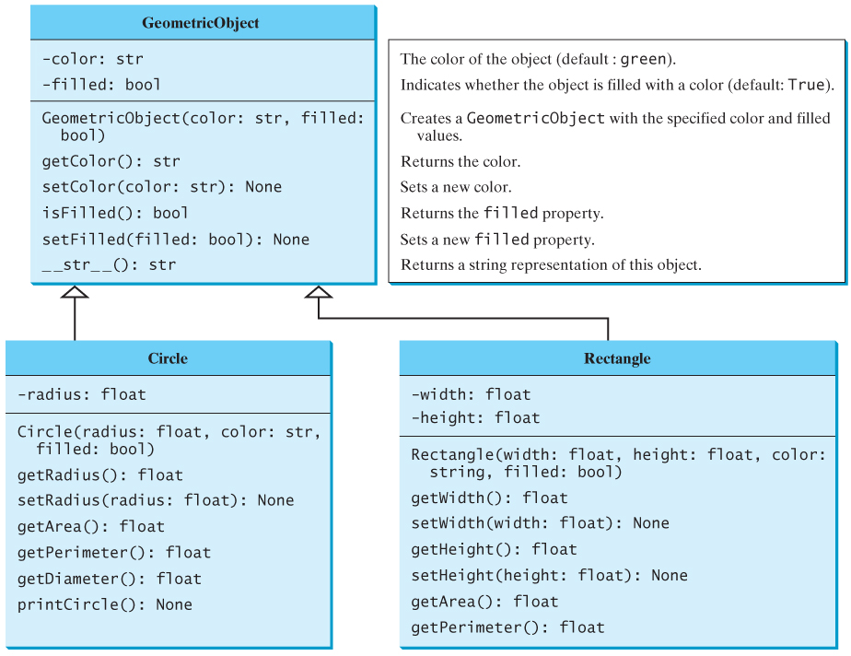
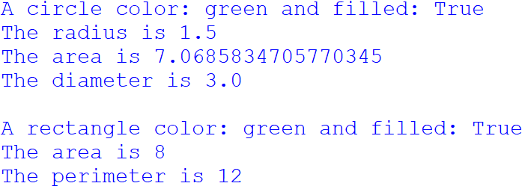
Exercise
Design the three classes based on the following UML Diagram. In the main method, create a circle and a rectangle object and use the appropriate accessor methods to display the different values of the two objects.

Slide 28
Summary
This chapter covered:
  Inheritance, including:
    “Is a” relationships
    Subclasses and superclasses
    Defining subclasses and initializer methods
    Depicting inheritance in UML diagrams
  Polymorphism
    Dynamic binding
    The isinstance function

